Slide 1
Gameplay
Session 09

Slide 2
Outline Material
Making game fun
The hierarchy of challenges
Space
Objects, attributes, states
Action
Rules
Skill
Chance
Case Study

Slide 3
Outline Material
Making game fun
The hierarchy of challenges
Space
Objects, attributes, states
Action
Rules
Skill
Chance
Case Study

Slide 4
Making game fun
Gameplay comes first
Get a feature right or leave it out
Design around the player
Know your target audience
Abstract or automate parts of the game that aren’t fun
Be true to your vision
Strive for harmony, elegance, and beauty

Slide 5
The hierarchy of challenges
Hierarchy from lowest to highest
Informing the player about challenges
Intermediate-level challenges
Atomic challenge
Sub-mission
Mission
Complete the game
Games tell the player about explicit challenges
Players discover implicit challenges on their own
Explicit instructions are given about the victory condition and lowest-level atomic challenges
The most interesting games offer multiple ways to win
Recognize and reward victory achieved no matter how the player achieves it

Slide 6
The hierarchy of challenges
Simultaneous atomic challenges
Overcoming several atomic challenges at the same time increases the difficulty
The more simultaneous atomic challenges a player faces under time pressure, the greater the stress
Common way of doing this is to bombard the player with enemies
Other games (such as management games) present more complex interrelated simultaneous challenges

Slide 7
Mechanic 1: Space
Every game takes place in some kind of space
This space is the “magic circle” of gameplay. It defines the various places that can exist in a game, and how those places are related to one another.
As a game mechanic, space is a mathematical construct. We need to strip away all visuals, all aesthetics, and simply look at the abstract construction of a game’s space.

Slide 8
Mechanic 1: Space
There are no hard and fast rules for describing these abstract, stripped down game spaces. Generally, though, game spaces:
Are either discrete or continuous
Have some number of dimensions
Have bounded areas which may of may not be connected

Slide 9
Mechanic 2: Objects, Attributes, and States
Your game space will surely have objects in it. Characters, props, tokens, scoreboards, anything that can be seen or manipulated in your game falls into this category
Objects are the “nouns” of game mechanics
Objects generally have one or more attributes, one of which is often the current position in the game space
Attributes are categories of information about an object. For example, in a racing game, a car might have maximum speed and current speed as attributes. Each attribute has a current state. Ex. Maximum Speed

Slide 10
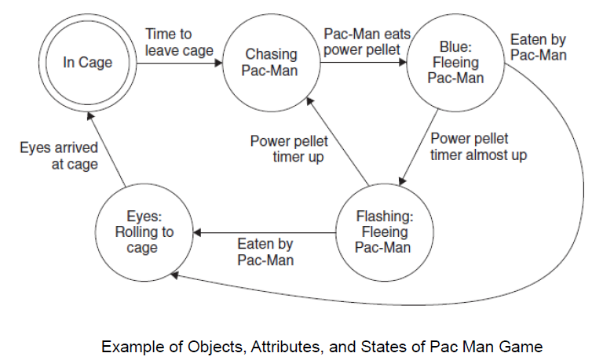

Slide 11
Mechanic 3: Actions
Actions are the “verbs” of game mechanics
The first kind of actions are operative actions
Example in Chest game:
Move a checker forward
Jump an opponent’s checker
Move a checker backwards (kings only)
The second kind of actions are resultant actions
Example in Chest game:
Protect a checker from being captured by moving another checker behind it
Force an opponent into making an unwanted jump
Sacrifice a checker to trick his opponent
Build a “bridge” to protect his back row
Move a checker into the “king row” to make it a king

Slide 12
Mechanic 4: Rules
The rules are really the most fundamental mechanic
Rules define the space, the objects, the actions, the consequences of the actions, the constraints on the actions, and the goals.
Rules make possible all the mechanics we have seen so far and add the crucial thing that makes a game a game goals.

Slide 13
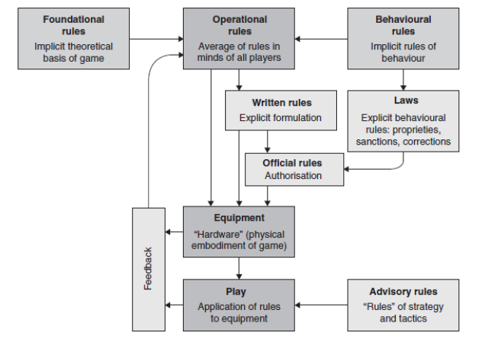
Mechanic 4: Rules
Parlett’s Rule Analysis

Slide 14
Mechanic 4: Rules
Operational Rules
Foundational Rules
Behavioral Rules
These are the easiest to understand
These are basically what the players do to play the game
When players understand the operational rules, they can play a game
The foundational rules are the underlying formal structure of the game.
Foundational rules are a mathematical representation of game state and how and when it changes.
These are rules that are implicit to gameplay, which most people naturally understand as part of “good sportsmanship”
Written Rules
These are the “rules that come with the game”, the document that players have to read to gain an understanding of the operational rules.

Slide 15
Mechanic 4: Rules
Laws
Official Rules
Advisory Rules
These only form when games are played in serious, competitive settings, where the stakes are high enough that a need is felt to explicitly record the rules of good sportsmanship, or where there is need to clarify or modify the official written rules.
These are created when a game is played seriously enough that a group of players feels a need to merge the written rules with the laws.
Over time, these official rules later become the written rules.
Often called “rules of strategy”, these are just tips to help you play better, and not really “rules” at all from a game mechanics standpoint.

Slide 16
Mechanic 4: Rules
Qualities
Concrete
Achievable
Rewarding
Good game goals have three important qualities, they are:

Slide 17
Mechanic 5: Skill
The mechanic of skill shifts the focus away from the game and onto the player.
Most games do not just require one skill from a player — they require a blend of different skills.
Skills can generally be divided into three main categories:
Physical Skills
These include skills involving strength, dexterity, coordination, and physical endurance
Mental Skills
These include the skills of memory, observation, and puzzle solving
Social Skills
These include among other things, reading an opponent (guessing what he is thinking), fooling an opponent, and coordinating with teammates.

Slide 18
Mechanic 6: Chance
Chance is an essential part of a fun game because chance means uncertainty, and uncertainty means surprises.
Five of the most important skill/chance interactions for a game designer to consider:
Estimating chance is a skill
Skills have a probability of success
Estimating an opponent’s skill is a skill
Predicting pure chance is an imagined skill
Controlling pure chance is an imagined skill

Slide 19
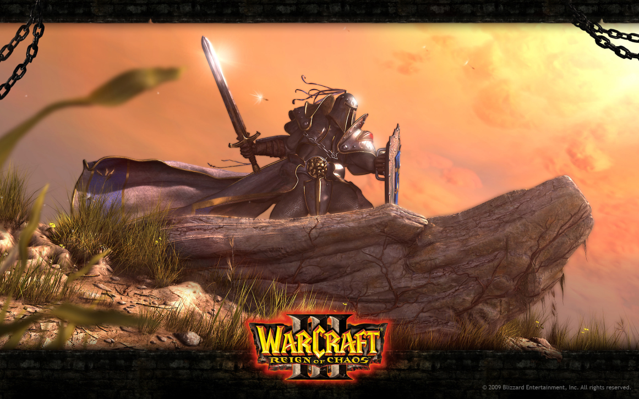
Case Study
Make a group of six and discuss about the Core Mechanics of following game:

